Slide 1
CSE 707
Distributed Computing Systems
Course Instructor: Annajiat Alim Rasel
Mehnaz Ara Faizul (ST)
Humaion Kabir Mehedi (RA)
Name: Ripa Sarkar
ID: 23366009
Group Number: 41

Slide 2
About
Title: Federated Learning for Medical Imaging: An Updated State of the Art
Author: Naoual Mouhni, Abderrafiaa Elkalay, Mohamed Chakraoui, Abdelmounaim Abdali, Abdelkarim Ammoumou, Ibtissam Amalou

Slide 3
Abstract
Deep neural network algorithms address challenges in medical imaging.
Lack of large public datasets, especially for rare diseases.
Federated Learning (FL) as a solution for multicenter datasets without compromising privacy.
UpToDate overview of FL for medical image analysis.

Slide 4
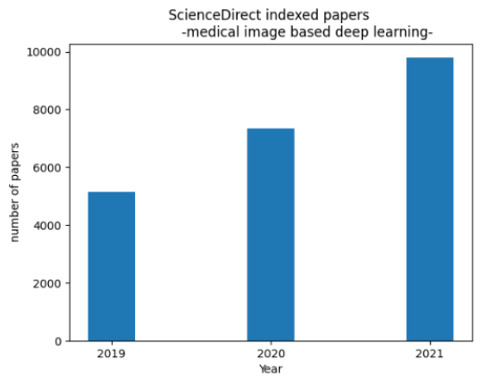
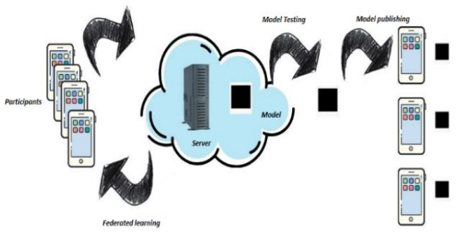
Introduction
Application of machine learning in healthcare due to the recent epidemic situation.
Success of AI-driven healthcare systems, especially in medical image analysis.
Challenges: dataset size, data privacy, and legal considerations.
Introduction of Federated Learning (FL) as a solution.
Use of FL in medical image analysis for security and accuracy improvements.
Figure 1. Evolution of the number of medical image-based deep learning papers indexed in ScienceDirect
Figure 2. Example of Google Tenser flow federated principle
with a coordinating server

Slide 5
Machine Learning Paradigms for Medical Imaging
Overview of computer-aided diagnosis (CAD) in medical imaging.
Categorization of medical image types (2D and 3D imaging).
Fragmented machine learning lifecycle: Training phase and Inference phase.
Centralized vs. distributed machine learning in medical imaging.

Slide 6
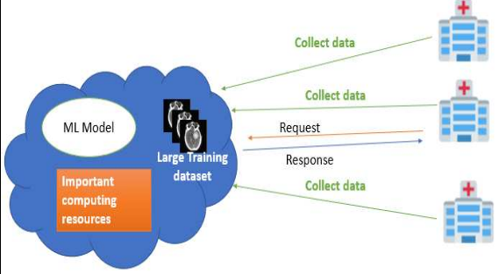
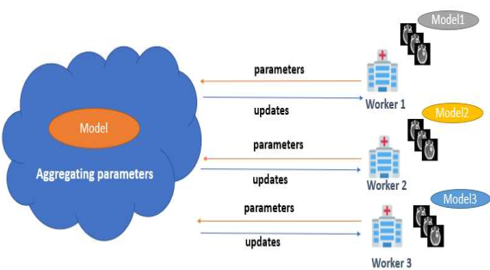
Figure 3. Centralized machine learning, where all the collected data are stored on a central server to be processed
Figure 4. Example of a distributed machine learning architecture with 3 Workers (nodes)

Slide 7
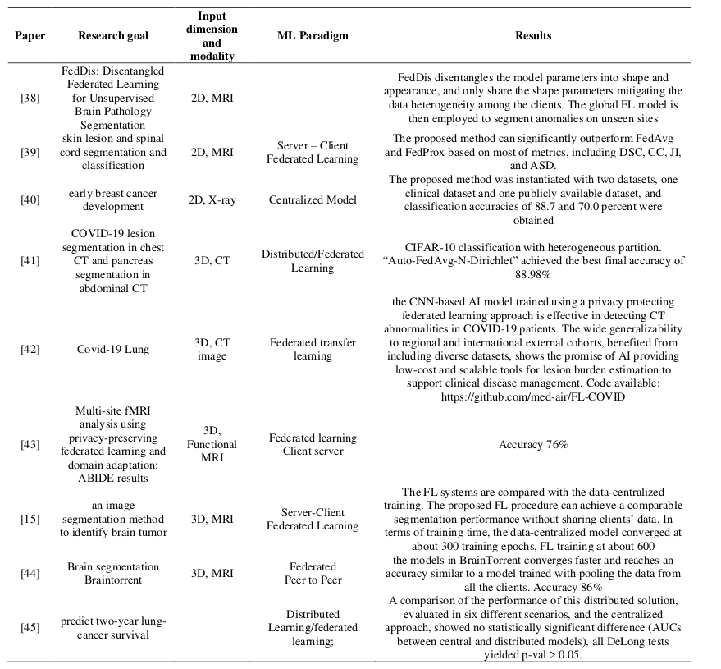
Table 1. Applications of deep learning in medical imaging analysis paper

Slide 8
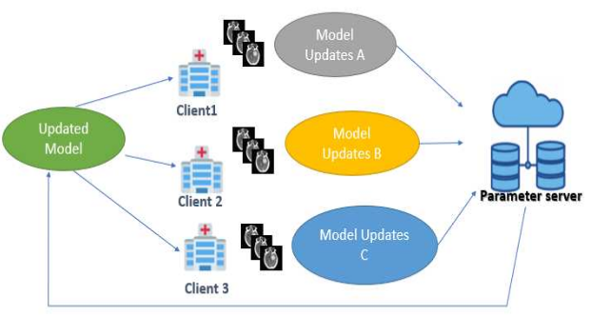
Federated Learning Architecture
Introduction to Federated Learning (FL) architecture.
Different FL architectures: Client-Server and Peer-to-Peer.
Privacy preservation in FL and its application in medical imaging.
Example architectures and frameworks for FL, including TensorFlow Federated (TFF).
Figure 5. Example of client server-based FL architecture

Slide 9
Federated Transfer Learning
Challenges in FL architectures.
Introduction of Federated Transfer Learning to overcome limitations.
Use cases in medical imaging, e.g., detection of Covid-19 abnormalities.
Exploration of Transfer Learning effectiveness in the medical imaging field.

Slide 10
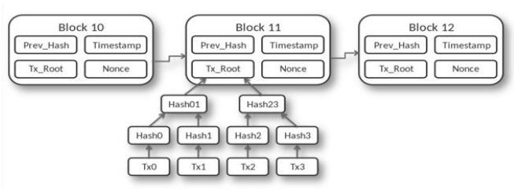
Blockchain and Federated Machine Learning
Introduction to blockchain technology in medical applications.
Enhancement of privacy and data security in Federated Learning (FL).
Discussion on potential malicious dataset injection in FL and blockchain's role.
Use cases and benefits of combining blockchain and FL in medical imaging.
Figure 6. Blockchain structure of Bitcoin, source:
https://commons.wikimedia.org/w/index

Slide 11
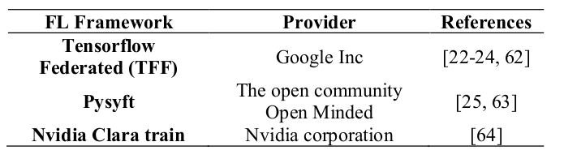
Federated Frameworks Development
Overview of cloud service providers offering distributed learning solutions.
Introduction of Federated Learning (FL) frameworks.
Different types of FL based on participating parties: Cross-silo and Cross-device.
Evolution of AI solutions in medical imaging through FL frameworks.
Table 2. The most important FL frameworks used in medical imaging

Slide 12
Discussion and Outlooks
Current success and challenges of AI-based medical imaging.
Evaluation of AI models' focus on minor abnormalities.
Impact of Federated Learning (FL) in overcoming data challenges.
Future directions, including the integration of FL with other technologies like Blockchain.

Slide 13
Conclusion
Enormous success of Federated Learning (FL) in medical imaging.
Overcoming challenges in centralized learning.
FL combined with technologies like Blockchain and Edge computing offers a comprehensive solution.
Revolutionizing AI-based medical solutions.

Slide 14
References
[1] Abdul Salam, M., Taha, S., Ramadan, M. (2021). COVID-19 detection using federated machine learning. PLoS One, 16(6): e0252573. https://doi.org/10.1371/journal.pone.0252573
[2] Gao, T. (2020). Chest X-ray image analysis and classification for COVID-19 pneumonia detection using Deep CNN. Preprint. Health Informatics. https://doi.org/10.1101/2020.08.20.20178913
[3] Wu, T., Tang, C., Xu, M., Hong, N., Lei, Z. (2021). ULNet for the detection of coronavirus (COVID-19) from chest X-ray images. Computers in Biology and Medicine, 137: 104834. https://doi.org/10.1016/j.compbiomed.2021.104834
[4] Wu, T., Tang, C., Xu, M., Hong, N., Lei, Z. (2021). ULNet for the detection of coronavirus (COVID-19) from chest X-ray images. Computers in Biology and Medicine, 137: 104834. https://doi.org/10.1016/j.compbiomed.2021.104834
[5] Bhattacharyya, D., Kim, T.H. (2011). Brain tumor detection using MRI image analysis. In International Conference on Ubiquitous Computing and Multimedia Applications, pp. 307-314. https://doi.org/10.1007/978- 3-642-20998-7_38
[6] Demir, C., Gultekin, S.H., Yener, B. (2005). Learning the topological properties of brain tumors. IEEE/ACM Transactions on Computational Biology and Bioinformatics, 2(3): 262-270. https://doi.org/10.1109/TCBB.2005.42

Slide 15
THANK YOU

